Slide 1
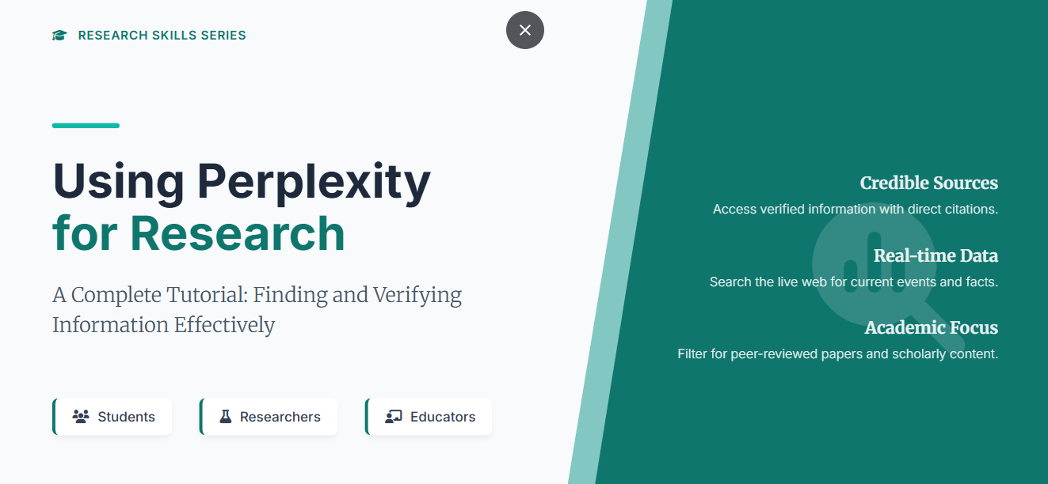


Slide 2
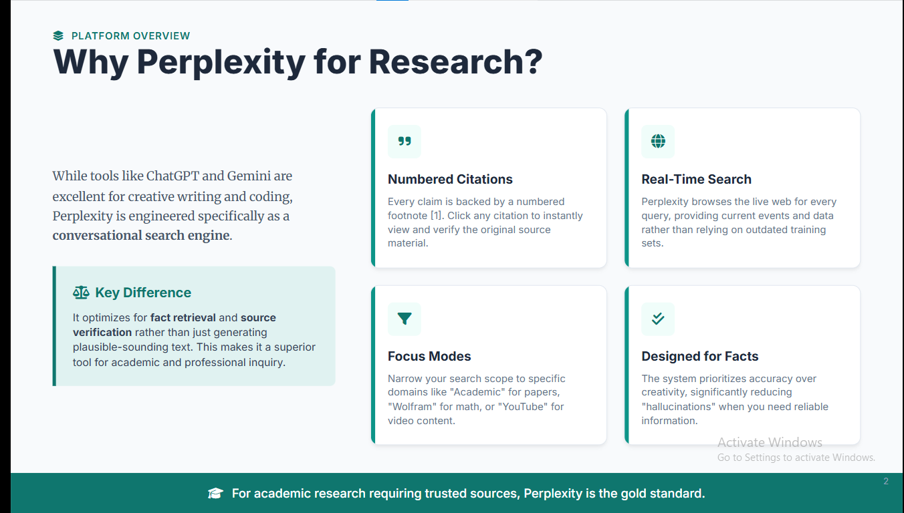

Slide 3
Part 1: Theory (The Mechanics of AI Research)
This presentation will guide college students through leveraging Perplexity AI for robust, citation-backed research, contrasting it with traditional search engines and chatbots.
1
Perplexity's Research-Focused Design
2
Citation Systems and Source Verification
Prompt 1: "Generate a slide for college students explaining the difference between a 'Chatbot' (like ChatGPT) and an 'Answer Engine' (like Perplexity). Focus on why citations are the default setting for research."
Prompt 1: "Draft a slide on 'How to read an AI-generated footnote.' Explain the process of clicking through to the primary source to ensure the AI hasn't taken the quote out of context."
Prompt 2: "Create a visual breakdown of the Perplexity UI, highlighting the 'Pro Search' toggle and 'Focus' modes, explaining how these reduce AI hallucinations compared to standard LLMs."
Prompt 2: "Explain the 'Source Transparency' feature in Perplexity. Write two bullet points on how students can use the 'View Sources' list to build a preliminary bibliography."
3
Academic vs. Web Sources
Prompt 1: "Create a comparison table for a multi-disciplinary audience: When to use 'Academic' focus (e.g., PubMed for bio students) vs. 'Social' or 'Web' focus for current market trends."
4
Fact-Checking and Reliability Assessment
Prompt 1: "Develop a 'Red Flag Checklist' for AI results. Include tips like checking for circular reporting (AI citing AI) and verifying the date of the source to ensure info isn't outdated."
Prompt 2: "Draft a slide titled 'The Credibility Gap.' Discuss the hierarchy of sources—from peer-reviewed journals found in Perplexity’s Academic mode to blog posts—and why it matters for college-level essays."
Prompt 2: "Generate a slide on the 'Trust but Verify' model. Explain how to use the 'Related Questions' feature in Perplexity to cross-reference a claim across different domains."

Slide 4
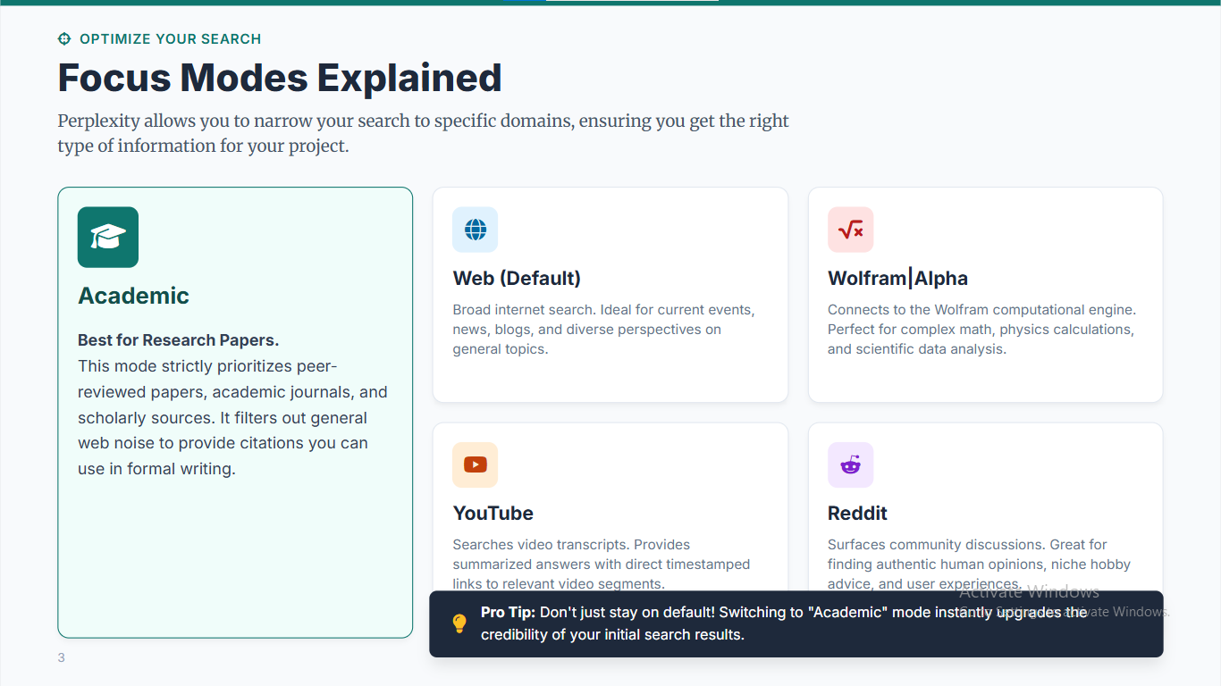

Slide 5
Part 2: Practical (Hands-on Lab)
1
Research Query Development
2
Source Evaluation Exercises
Prompt 1: "Create a 'Prompt Level-Up' slide. Show a basic prompt ('Tell me about climate change') vs. a multi-disciplinary research prompt ('Analyze the economic impact of carbon taxes on EU agriculture using data from 2020-2024')."
Prompt 1: "Design a 5-minute 'Source Audit' activity. Ask students to run a query on a controversial topic and identify if any of the top 5 sources provided by the AI have a commercial bias."
Prompt 2: "Draft an exercise: 'The Perspective Shift.' Instructions for students to ask Perplexity to explain a single topic (e.g., 'Blockchain') from three different disciplinary lenses: Computer Science, Economics, and Ethics."
Prompt 2: "Create a slide with a 'Critique the AI' task. Provide a sample AI response and ask students to find one sentence that is a 'generalization' and find a source via Perplexity to make it 'specific'."
3
Citation Tracking and Verification
4
Comparative Research Projects
Prompt 1: "Write a step-by-step guide for the slide: 'Exporting Your Research.' Explain how to copy-paste citations into citation managers like Zotero or Mendeley."
Prompt 1: "Generate a 'Battle of the Engines' project slide. Instructions: Compare a search on Google Scholar vs. Perplexity Academic. Which gave faster results? Which gave more diverse perspectives?"
Prompt 2: "Draft a 'Reverse Search' exercise: Give students a claim and have them use Perplexity to find the original study or government report that first published that data."
Prompt 2: "Create a 'Project Roadmap' slide for a 15-minute mini-research task: Use Perplexity to find 3 sources, verify them, and write a 1-paragraph summary with proper in-text citations."

Slide 6
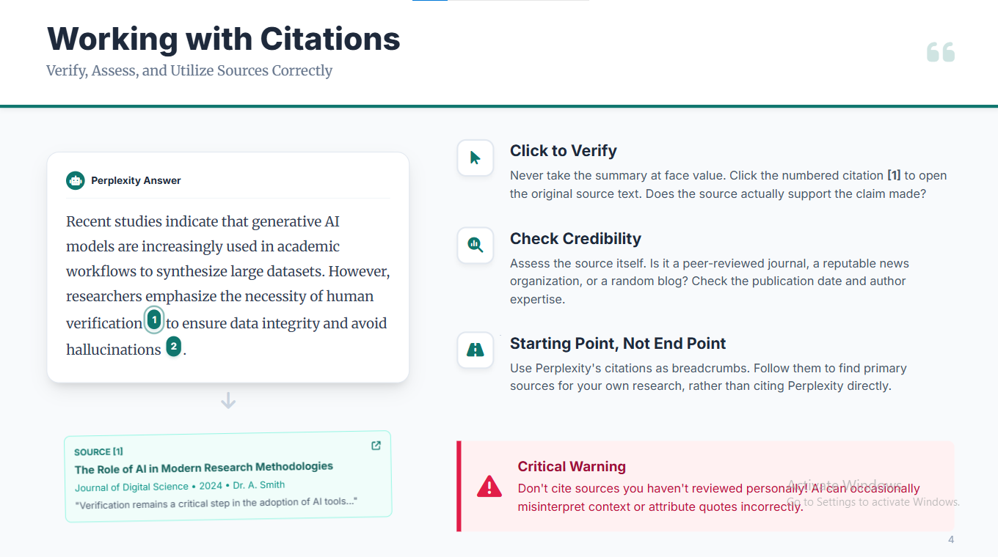

Slide 7
Prompts by Discipline
Engineering
"Explain how neural networks function with real-world applications illustrated through case studies"
Literature
"Analyze the main character motivations in [Book Title] and compare to modern social values"
Social Science
"Summarize key economic trends affecting Gen Z spending patterns in 2026 with statistical evidence"

Slide 8
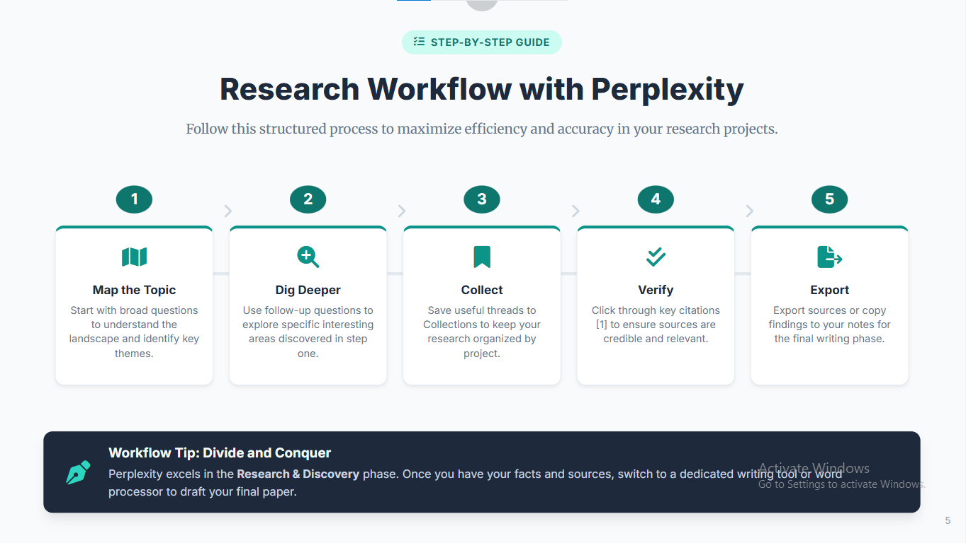

Slide 9
Focus Modes Explained
Choose the right search mode to target the specific types of sources you need for your research.
Academic
1
Prioritizes peer-reviewed papers, academic journals, and scholarly publications from databases like PubMed, JSTOR, and arXiv
Web
2
General internet search that pulls from diverse sources including news sites, government publications, and organizational websites
Wolfram
3
Uses Wolfram Alpha computational knowledge engine for math, science, engineering, and data analysis queries
YouTube
4
Searches video content and provides timestamped references to specific moments in educational videos and lectures
Reddit
5
Explores Reddit discussions for community opinions, personal experiences, and crowdsourced knowledge sharing

